Slide 1
Project Name :- Forecast Gold Prices
Team 3 Participants:- 1) Rukhsar Tamboli
2) Vilas Tade
3) Akshay Ramteke
4) Lokesh Putta
5)Darshana Yenkar
Mentor Name :- Varun Sir
Date :- 11-Augest-2021

Slide 2
Business Objective
Data provided is related to gold prices. The objective is to understand the underlying structure in your dataset and come up with a suitable forecasting model which can effectively forecast gold prices for next 30 days.
This forecast model will be used by gold exporting and gold importing companies to understand the metal price movements and accordingly set their revenue expectations.

Slide 3
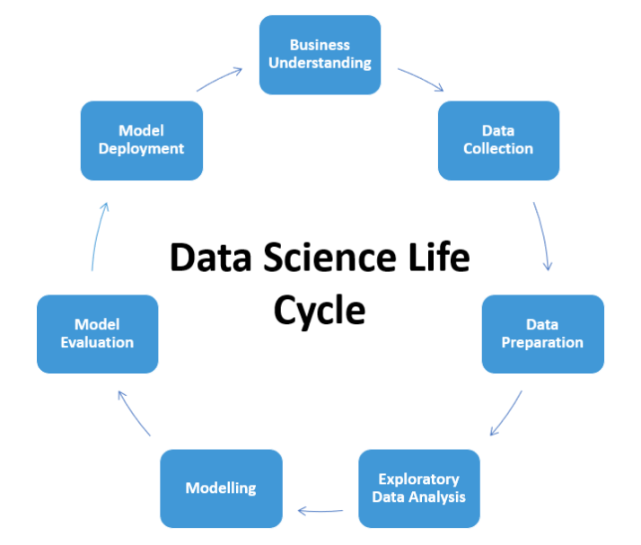
Project Architecture / Project Flow

Slide 4
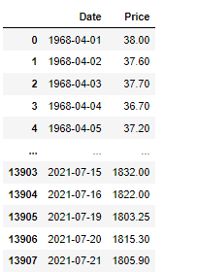
Data Collection & Details
13908 rows & 2 column
Year range 01-04-1968 to 21-07-2021
Unique Date Values 13908 and Price 7840
Null value 431
These are the explanations for variables.
1) Date (object) : Daily entry
date
2) Price (Float64) : Gold Price

Slide 5
Exploratory Data Analysis (EDA) & Visualization
Exploratory Data Analysis is an approach of analyzing data sets to summarize their main characteristics, often using statistical graphics and other data visualization methods.
Visualization is any technique for creating images, diagrams, or animations to communicate a message.

Slide 6
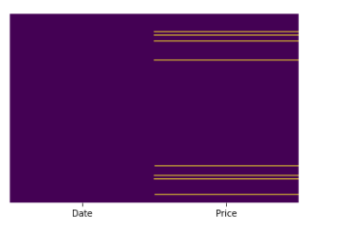
Missing Values & Imputation
There are total 431 null values in the dataset.
The null values are mostly on weekends.
Removing all null values could cause a data loss of around one & half year.
So refill null values with the help of “Interpolation function”.

Slide 7
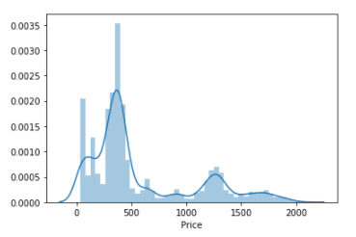
Distplot of Price density

Slide 8
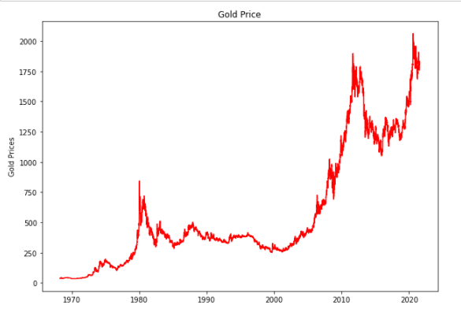
Lineplot of Gold Price

Slide 9
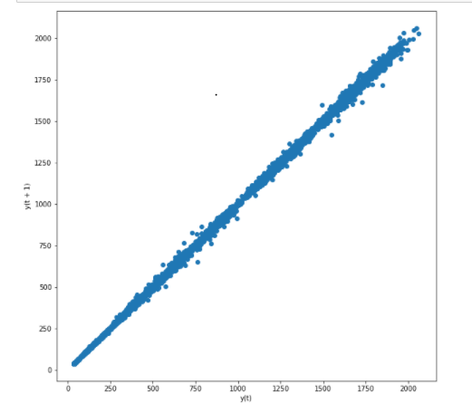
Lag_Plot

Slide 10
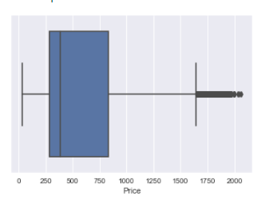
Outlier Detection

Slide 11
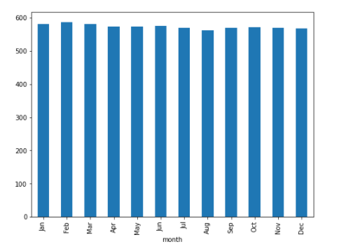
Month wise Price Distribution

Slide 12
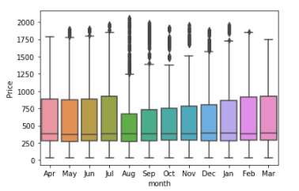
Month wise Outlier Detection

Slide 13
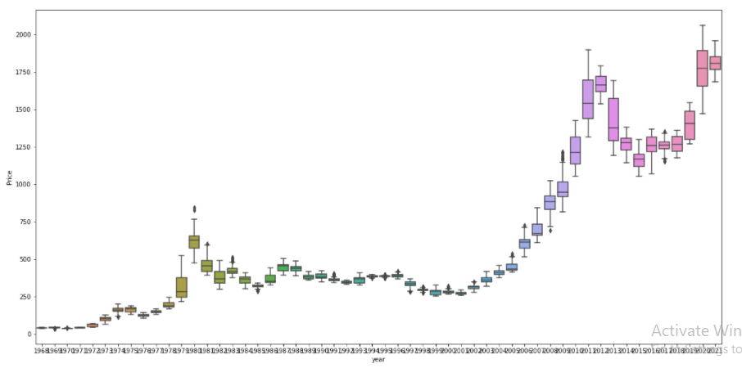
Year wise Outlier Detection

Slide 14
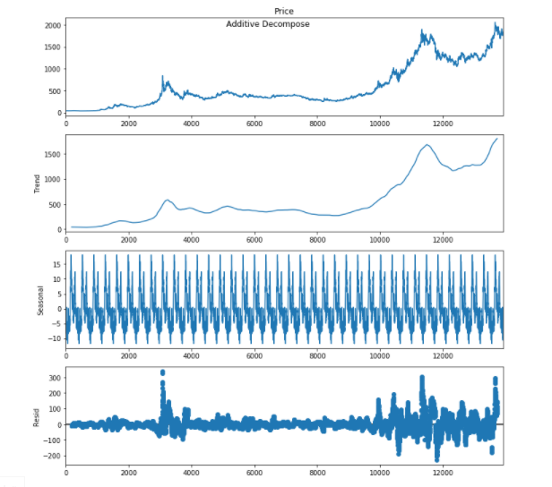
Decomposition Plot: Additive Decompose

Slide 15
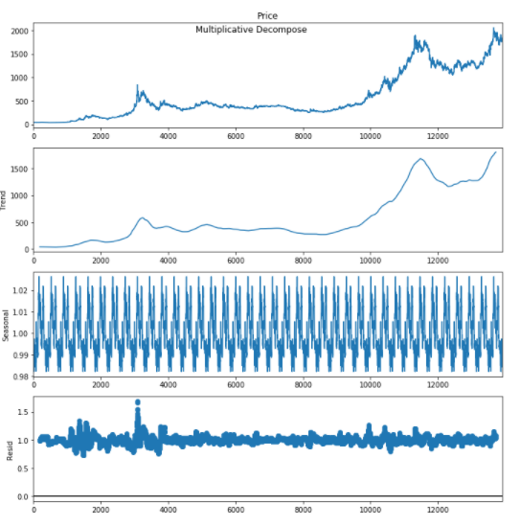
Multiplicative Decompose

Slide 16
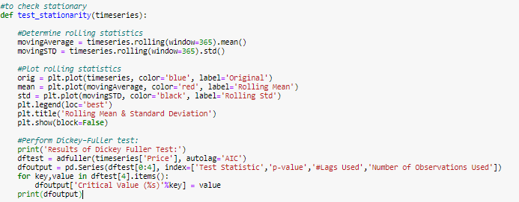
Checking stationarity of dataset
Here we used Rolling Test and Dickey-Fuller test statistics to check the stationarity of dataset.

Slide 17
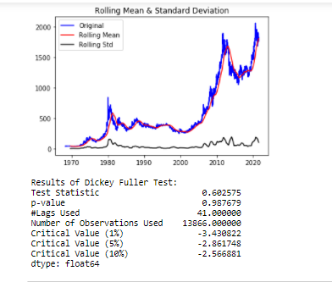
Here we used Dickey-Fuller test statistics to check the stationarity of dataset.
From Rolling Statistic Test we observed that rolling mean and standard deviation are not constant over a time period .
By applying the Dickey-Fuller test on original dataset, we got p-value more than the critical value, i.e. 0.05. Hence it shows the data is non-stationary.

Slide 18
International Gold Price Movement 1968 To 2021 Reason
GOLD PRICE INCREASE IN ECONOMIC CRISES
The relationship between gold prices and stock markets is inverse. More often than not, the gold prices would drop when the stock markets perform well and vice versa.
When the stock markets collapse, the demand for gold increases as more and more investors would be looking at safer options.
Gold is considered one of the most secured investment options as the chances of gold losing its entire worth is almost non-existent. Gold prices may fluctuate but will never be collapsing to zero.
It is for this very reason that the prices of the yellow metal shoot up at times of uncertainty or economic crisis or war .

Slide 19
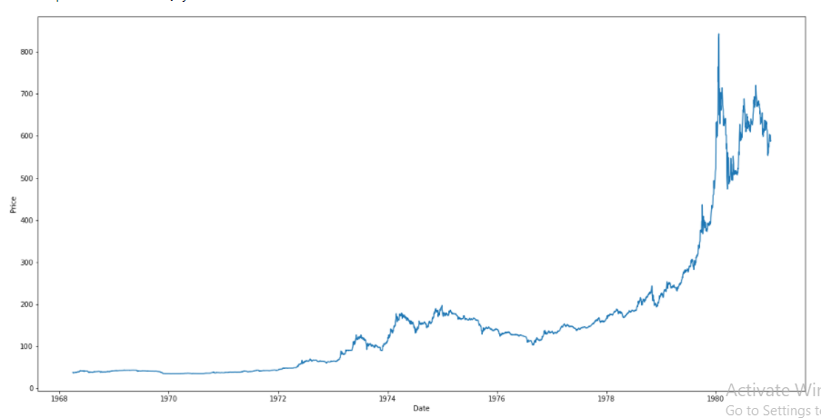
Decade 1968-1980

Slide 20
Decade 1968-1980 movement reason
In 1971, the United States suspended the free exchange of U.S. gold for foreign-held dollars.
then in 1974 lifted its four-decade ban on the private purchase of gold.
Gold price traced out two principal cycles during a the (Decade moving up, from 1971 it reached a peak in December 1974, then fell till the third quarter of 1976, rose again till early 1980.
In 1976 – 1978 less inflation
Russian invasion of Afghanistan in Dec 1979, Iran hostage crisis.
In this decade gold price rise 37.375$ to 589.500$

Slide 21
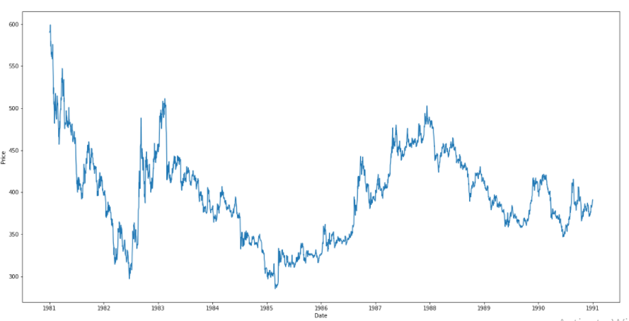
Decade 1981-1990

Slide 22
Decade 1981-1990 movement reason
In 1980 to 1982 the inflation is high
In 1987 the USA stock market collapse (black Monday)
In this decade gold price start 592$ to End 391$

Slide 23
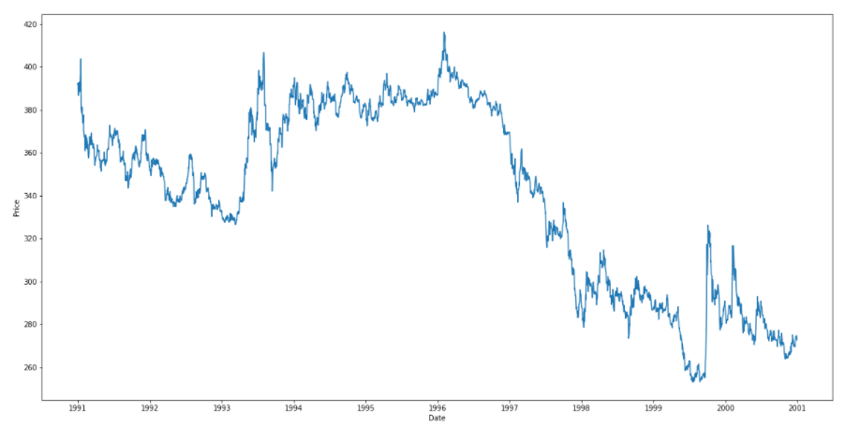
Decade 1991-2000

Slide 24
Decade 1991-2000 movement reason
Recession in early 1990s
In 1999 to 2001 the dot com bubble burst.
In this decade gold price start 392.500$ to End 272.650$

Slide 25
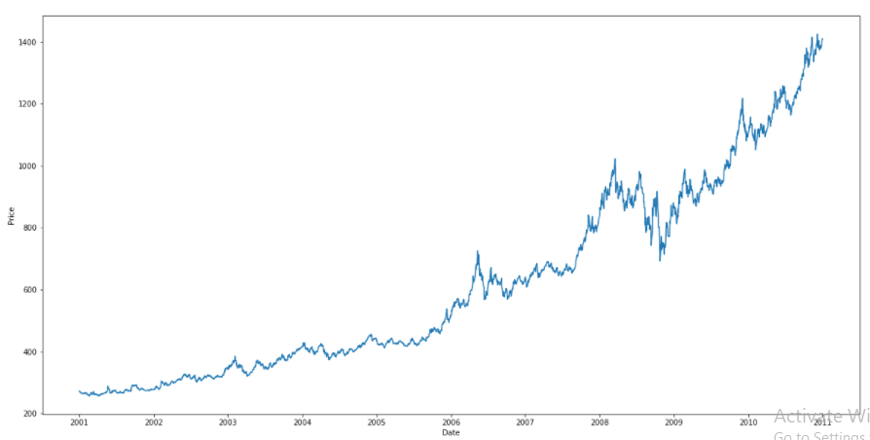
Decade 2001-2010

Slide 26
Decade 2001-2010 movement reason
In 1999 to 2001 the dot com bubble burst.
Stock market crash .
In 2001 the wars in Afghanistan
In 2007 to 2009 housing financial meltdown in banking sector.
In this decade gold price rise 272.800$ to 1410.250$

Slide 27
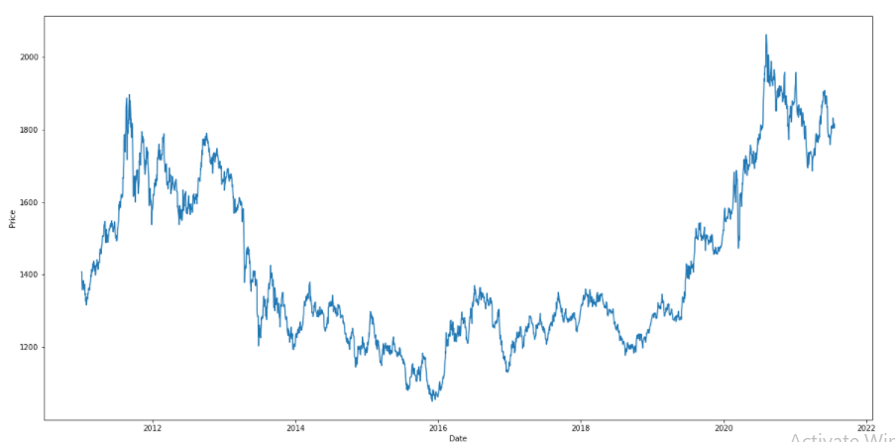
Decade 2011-2021

Slide 28
Decade 2011-2020 movement reason
In 2011 Japan's Tsunami and Nuclear Disaster
In 2015 Greek Debt Crisis Threatens European Union as Eurozone debt crisis.
In 2016 Brexit Event
In 2019 due to covid-19 pandemic
In this decade gold price start 1405.500$ to End 1891.100$
Average return 10 to 11% form 1968 to 2021

Slide 29
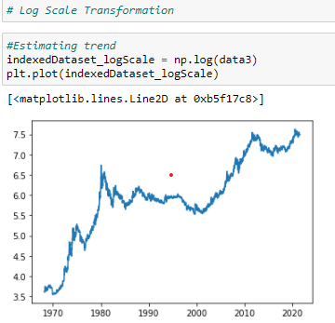
Log Scale Transformation
To make the data stationary we used log Exponential Decay &Time Shift Transformation, after doing this transformation, we got p-value less than the critical value.

Slide 30



Log Transformation

Slide 31
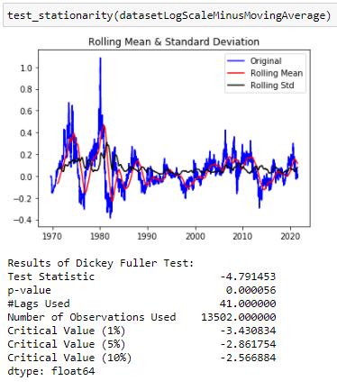
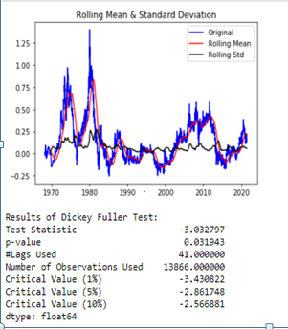
Result of stationarity Test
After Log Transformation
After Expontional decay Transformation

Slide 32
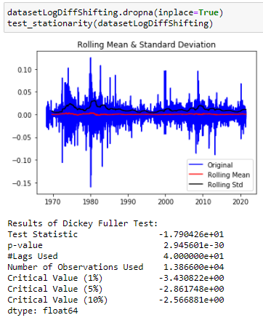
After Time shift Transformation

Slide 33
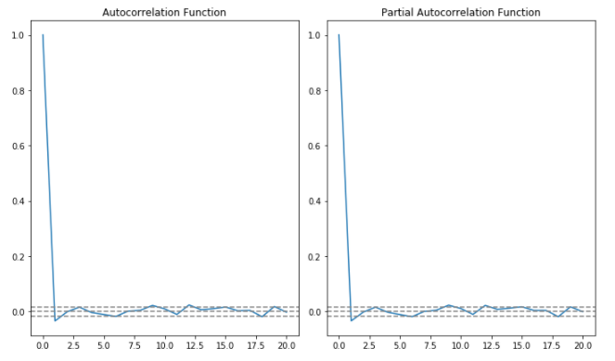
Autocorrelation and Partial auto correlation

